Slide 1
Economic Decision-Making and Everyday Choices

Slide 2
A key area of economics is about studying trade-offs what do you gain and what do you give up with each decision
Notes:
Next slide provides example of a trade-off, and how sometimes how options are presented to us affects how we perceive their value.

Slide 3
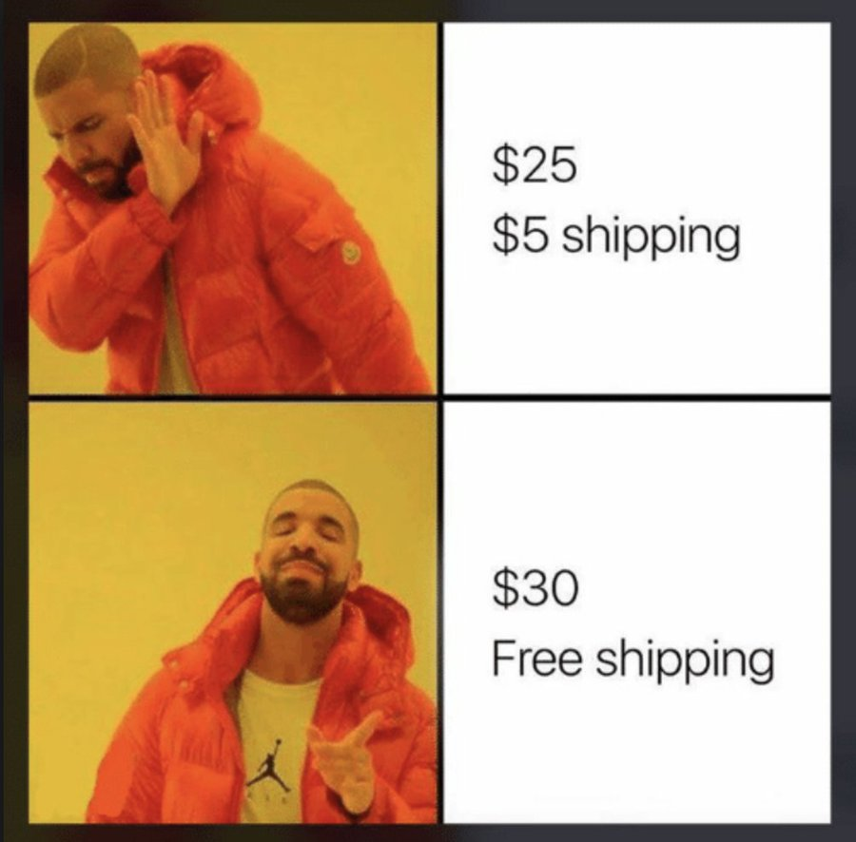
Notes:
Sometimes, costs are easier to spot, and sometimes, they are easy to miss.
Who has fallen for this?

Slide 4
Every decision comes with costs and benefits
💸 ⏱️ 😊 😮‍💨
Notes:
Costs and benefits can come in many forms: money, time, happiness or joy, energy, effort, relationships with others or trust.
These are all the things you considered when planning your weekend. Today, we are going to discuss a specific type of cost that comes up a lot in decision making, and in thinking about the trade-offs between options when you are making a decision, and that is opportunity cost.

Slide 5
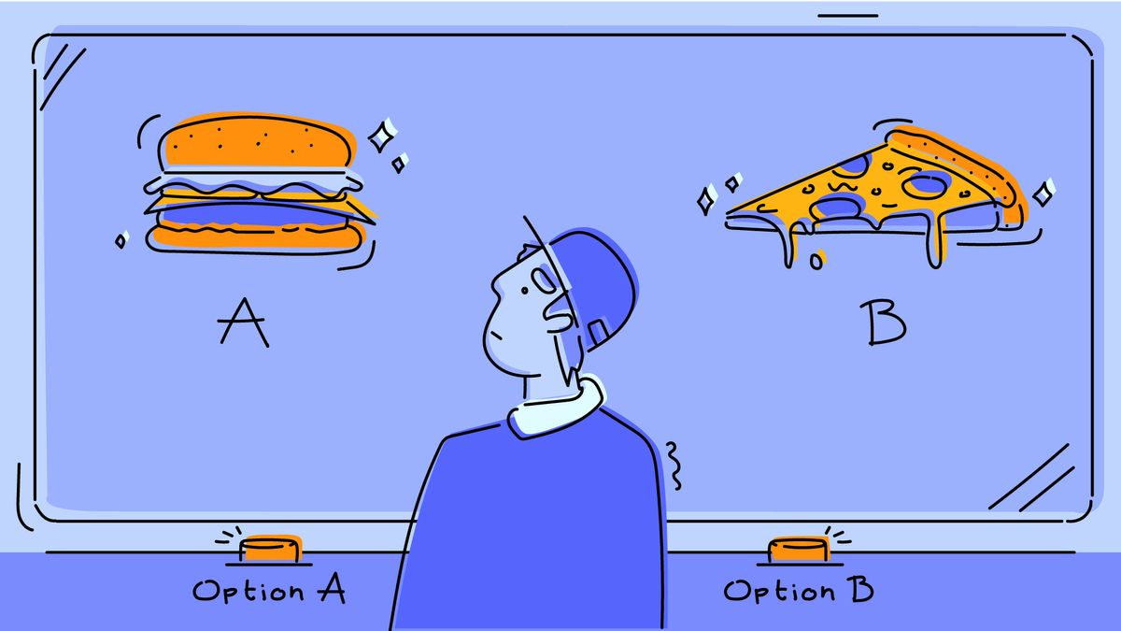
Opportunity Cost

Slide 6
Opportunity Cost
It's what you give up
The value of the next best option (the one you did NOT choose) when a decision is made
Notes:
In other words, the value of the next best alternative

Slide 7
If you are given $100 today, what is the opportunity cost of saving it?
Notes:
Can allow students to try to answer if they are engaged. Otherwise, can throw out some examples. Recall, the opportunity cost is the next best option, so it will differ person-to-person. It could be buying a pair of shoes you really want. It could be buying a nice lunch and saving $85 (the remainder). It could be loaning it to your friend and getting $120 back next year.

Slide 8
Everyone has a different opportunity cost
they may value
💸 ⏱️ 😊 😮‍💨
differently
Notes:
Because everyone values costs and benefits (time, money, love, happiness) in all forms differently.

Slide 9
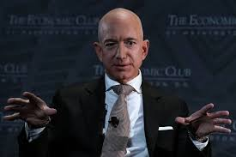
What is the opportunity cost of saving $100...
for him?
Notes:
Basically $0, because he doesn't have to give anything up – he already has enough money to do whatever he wants. "When you're worth over $200 billion, $100 is so vanishingly small relative to your wealth that whatever you give up by not spending it — a coffee, a book, a nice lunch — doesn't register. It's like you deciding not to pick up a penny off the sidewalk."

Slide 10
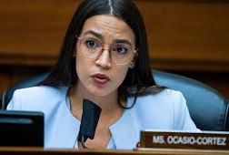
What is the opportunity cost of saving $100...
for her?
Notes:
For Alexandria Ocasio-Cortez, the opportunity cost of saving $100 is real but modest. She earns a congressional salary of $174,000 a year — comfortable, but not "forget about it" money. That $100 saved might mean skipping a nice dinner out in DC, where things aren't cheap, or passing on a new outfit.
What makes her case interesting is that before Congress, she was bartending and struggling with student loans. Back then, saving $100 might have meant choosing between groceries and a metro pass. Now it's a manageable tradeoff, but still one she'd actually feel — unlike Bezos, where it's invisible.

Slide 11
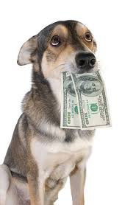
What is the opportunity cost of saving $100...
for him?
Notes:
The opportunity cost is the fun of ripping it apart and eating it.
The dog doesn't know or care that it's $100. It cares that it's a satisfying thing to chew. So the opportunity cost of not eating it is measured in chewing pleasure :)

Slide 12
Everyone has a different opportunity cost
It is why different people make different choices

Slide 13
A "good" choice is one where the benefits are greater than the opportunity cost
Notes:
"A choice makes sense when expected benefits are greater than expected costs, where expected cost should be measured by the opportunity cost."

Slide 14
Weekend Planning Activity
Notes:
Stop here to do worksheet on planning a great weekend. "Now you’ll use the ideas we just covered to help you to make a realistic decision under constraints: planning your perfect weekend.”
Break students into small groups to complete the worksheet. Then come back together and discuss.
Note: worksheet will preview sunk cost concept before the lecture covers it official (that's intentional)

Slide 15
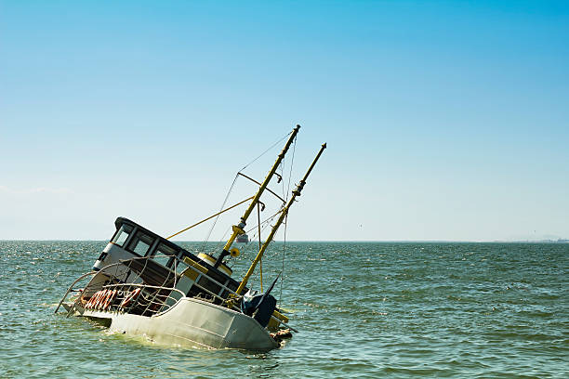
Sunk Cost

Slide 16
Sunk Cost
A cost you cannot recover
Money, time, or effort already spent

Slide 17
Sunk cost fallacy
Considering sunk costs when making decisions about the future
To stay on a path because you've already invested in it, even if it's not the best decision looking forward

Slide 18
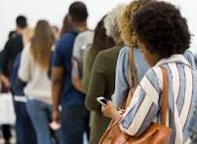
sunk cost fallacy
staying in line because "we've already waited 20 minutes"

Slide 19
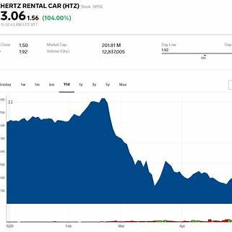
sunk cost fallacy
Notes:
Image you bought Hertz stuck in February 2020. The pandemic just started, and people were renting cars to avoid flying. You thought it would be a good investment because you thought the share price was going to continue to go up.

Slide 20
sunk cost fallacy
Notes:
Then, in March 2020, Hertz stock price plummeted. There were stay-at-home orders and no one was travelling. What should you do next? Poll the class: who thinks it's going to go back up?
Most people will consider the fact that they already invested so much (bought in so high) when they are deciding whether or not to sell the stock. But this is the sunk cost fallacy. You cannot recover the money you have already invested—you should only think about the future when deciding whether or not to sell. In other words, if you had extra money in May of 2020, would you buy more Hertz stock with it, because you think it's going to make a profit in the future? If the answer is no, then you should not continue to hold the stock now.

Slide 21
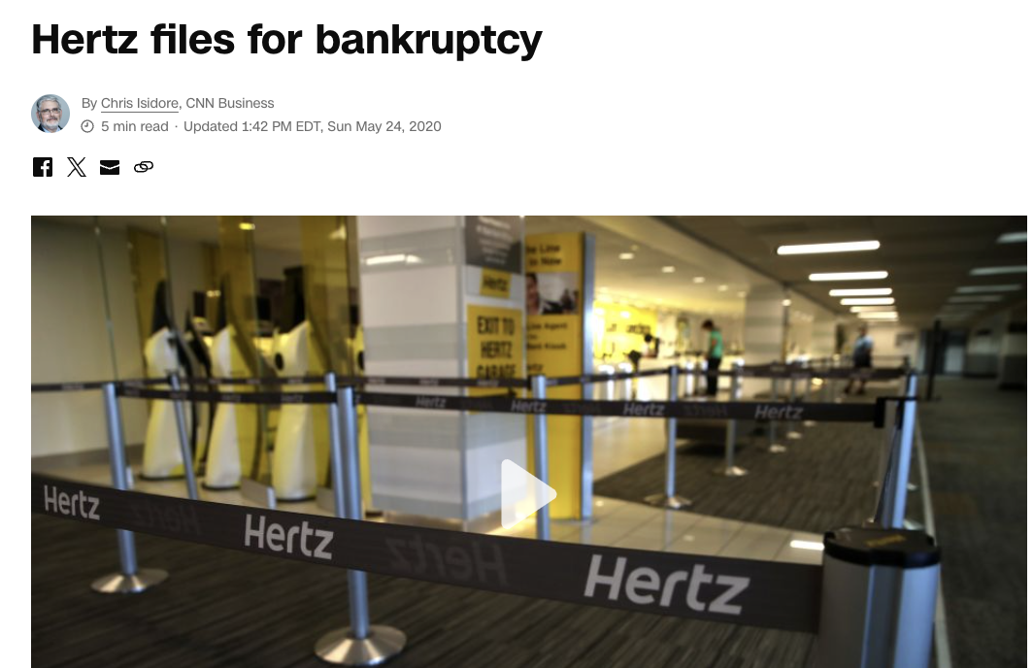
sunk cost fallacy
Notes:
You cannot recover the money you have already invested—you should only think about the future when deciding whether or not to sell. In other words, if you had extra money in March of 2020, would you buy more Hertz stock with it, because you think it's going to make a profit in the future? If the answer is no, then you should not continue to hold the stock now. You should take your money that is left and invest it elsewhere…...In the end, Hertz filed for bankruptcy in May of 2020.

Slide 22
Sunk cost quiz
https://mru.org/courses/principles-economics-microeconomics/sunk-cost/interactive-practice
Notes:
You can play this quiz/game at the link – IF YOU NEED TO FILL MORE TIME. Otherwise, SKIP IT.

Slide 23
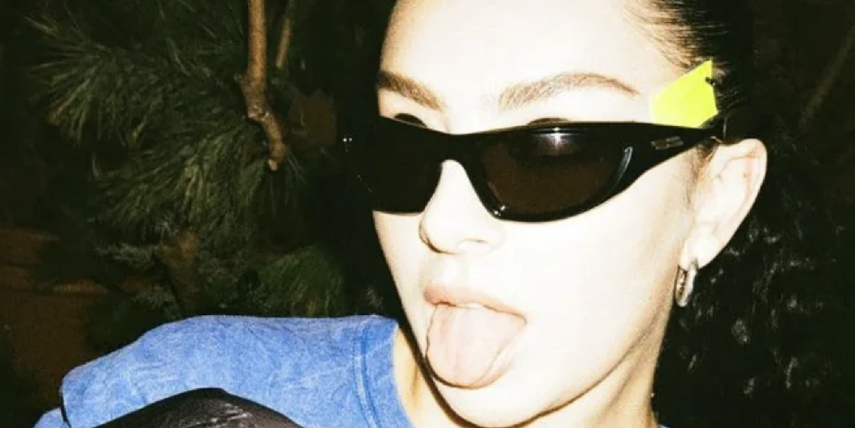
Why do we care?
Notes:
Opportunity costs and sunk costs are economic concepts that can help us making better decisions in our own lives, and they can help us evaluate policy decisions. Next, we are going to use the two concepts to evaluate a recent local policy: phone-free school days.

Slide 24
Economic analysis: Is "phone-free school days" a good policy?
Notes:
“Economists use the same tools to evaluate both personal and policy decisions.”

Slide 25
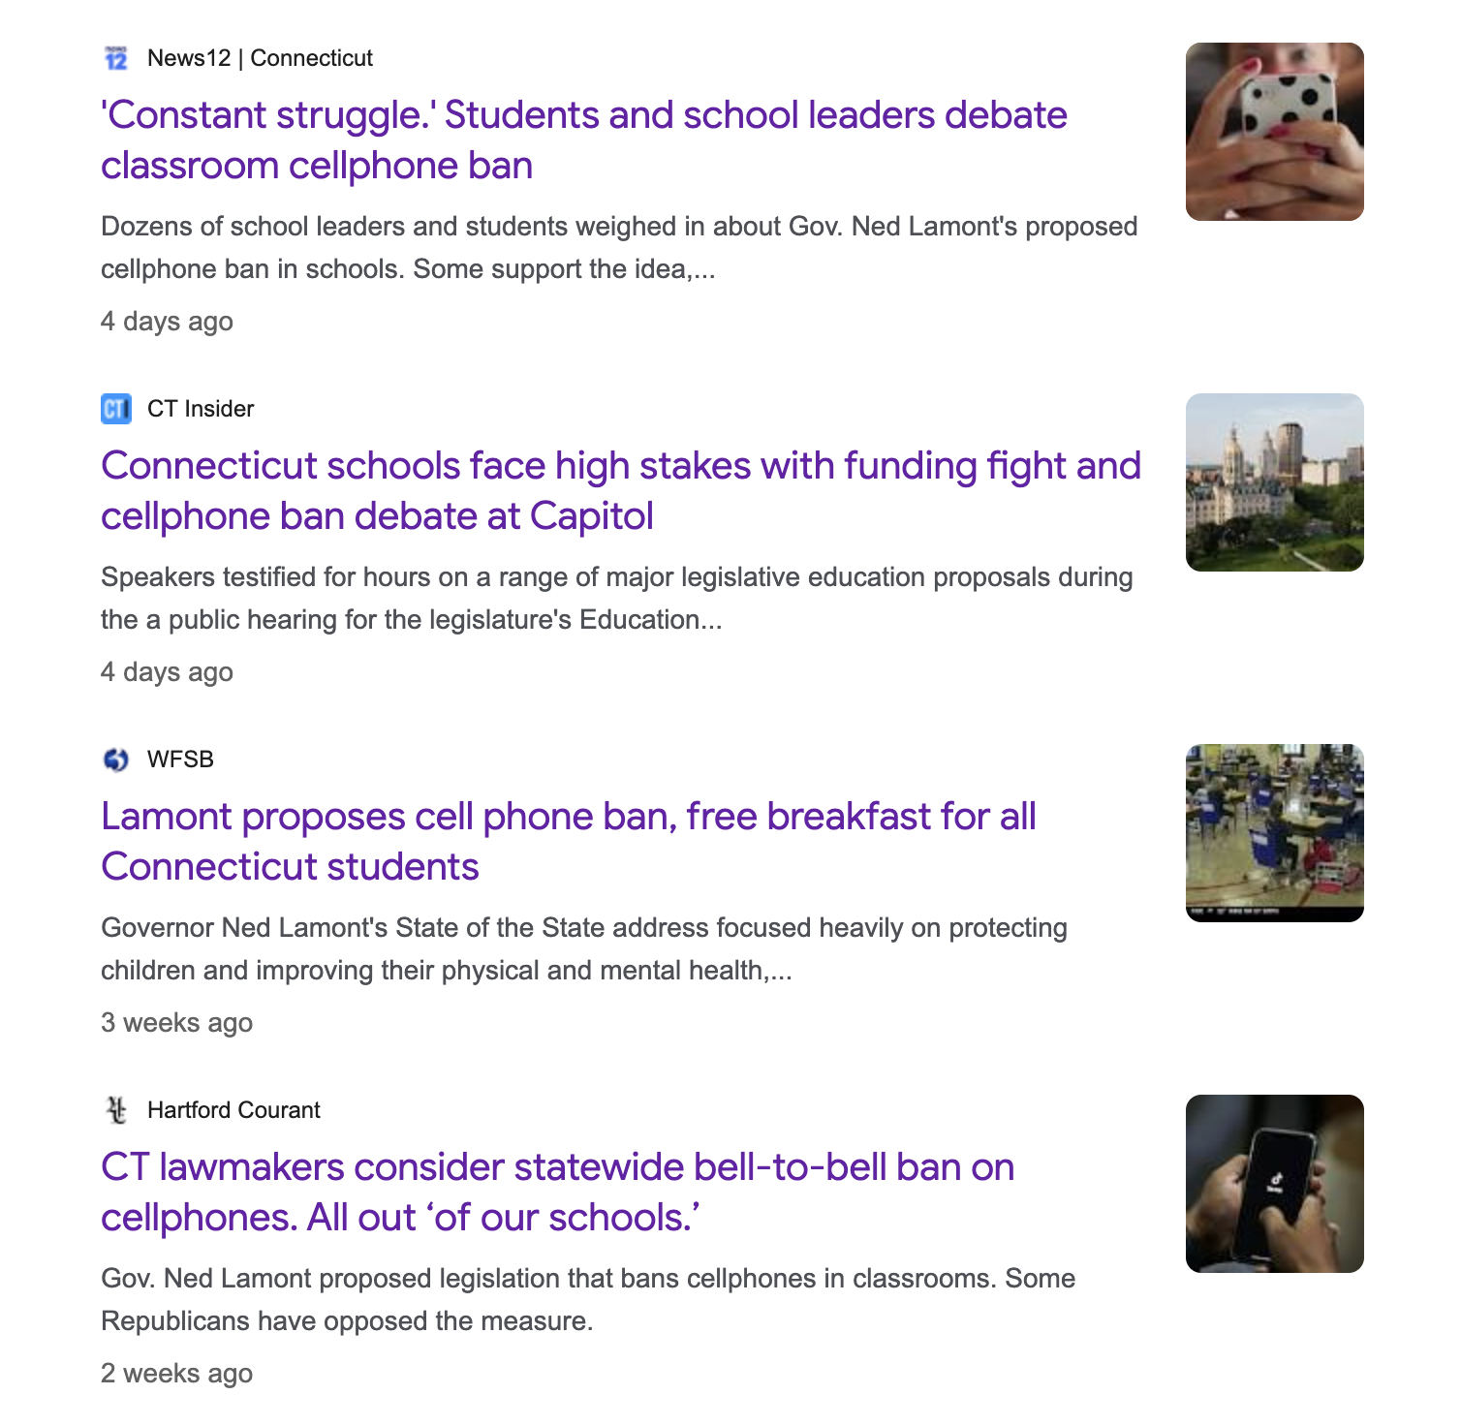
Policy debate
Should we pass a bell-to-bell phone ban law?

Slide 26
"...And turn off the damn smartphone.” - Gov. Lamont
In Connecticut
2024 - CT’s State Board of Education recommends heavy restrictions for elementary/middle, with more flexibility for high school.
2025 - multiple bills introduced in the CT legislature about limiting phone use in schools.
2026 - Gov. Lamont publicly backed a “bell-to-bell” no-phone approach and lawmakers discussed a statewide ban again at the start of the 2026 session
In New Haven
Jan 2025 - New Haven Public Schools planned a cell phone-free policy starting with elementary + middle schools
Fall 2025 - reporting indicates NHPS expanded restrictions to high schools

Slide 27
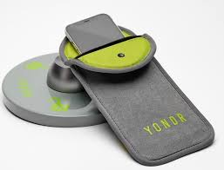
Smartphone ban discussions in the media
https://www.tiktok.com/@cbssundaymorning/video/7557729291417505079
https://www.tiktok.com/@wfsbnews/video/7602419644909063455
https://www.tiktok.com/@bridge.michigan/video/7605333341490941197

Slide 28
Policy debate: Should we pass the bell-to-bell phone ban law?
Three groups: teachers, students, government
Discuss within groups: 10 mins
Debate across groups: 5 mins
Final policy design

Slide 29
Within group discussion: 10 mins
What is your goal?
List at least 2 opportunity costs if phones are banned bell-to-bell
What are you giving up if you choose/drop the ban?
Who pays the cost—students, teachers, government, parents, taxpayers?
List at least 1 sunk cost people keep bringing up (and why it’s tempting)
Is that cost already paid and unrecoverable?
Are we protecting learning… or protecting our pride?
Your policy stance:
Who benefits most from a ban? Who might be harmed?
Option 1: Bell-to-bell ban (pouches)
Option 2: Instruction-time only
Option 3: Teacher-by-teacher rules
Option 4: No restriction

Slide 30
Students
Opportunity costs:
Losing convenience (music, plans, social during breaks)
Losing perceived safety/connection
Losing autonomy (feels like distrust)
opportunity cost of not banning: losing attention, learning, real social time
Sunk cost:
“I paid $1,000 for this phone, so I should use it” (classic sunk-cost trap)
Compromise ideas:
Phone-free instruction + phone access in lunch/common areas, or “graduated privileges” by grade

Slide 31
Teachers
Opportunity costs:
Time spent enforcing → less teaching/relationship-building
Stress/conflict with students → classroom climate cost
Less flexible use for learning activities that do use phones
Sunk cost:
“We already trained staff / bought pouches” (spent money + effort)
Compromise ideas:
Bell-to-bell for middle school, instructional-time for high school; clear emergency exceptions

Slide 32
Government (state+district)
Opportunity costs:
Money + staff time implementing (pouches, lock stations, monitoring)
Political capital / backlash; local control vs statewide mandate
Tradeoff with other priorities (mental health supports, tutoring, etc.)
Sunk cost:
“We already announced it publicly” (reputation/PR sunk cost)
Compromise ideas:
State sets a model policy; districts choose implementation (mandate outcomes, not methods)

Slide 33
Thank you!

